Slide 1

Student Details:
Name: MBOUALA AKIANA ELIUD
Skillsbuild id: akianaeliud_mbouala@srmap.edu.in
College Name: SRM AP
College State: Andhra Pradesh
Internship Domain: Data Analysis
Internship Date: 3rd June 2024 – 25 July 2024

Slide 2
Analysis of Car Sales Data to Determine Factors Affecting Depreciation and Market Trends
Problem Statement
The goal of this project is to analyse car sales data to uncover insights regarding vehicle depreciation, market trends, and factors affecting the resale value of cars.
The project aims to provide valuable information for potential car buyers, sellers, and dealers.

Slide 3
AGENDA
Introduction to the project and its objectives
Data Collection from Kaggle
Data exploration and understanding
Data cleaning and preparation
Descriptive statistics and initial observations
Analysis of vehicle depreciation
Identification of factors affecting selling prices
Visualization of key findings
Insights and recommendations
Conclusion

Slide 4
PROJECT OVERVIEW
This project involves analysing a dataset of car sales to understand the trends and factors influencing car depreciation and resale value.
The dataset includes information such as car name, manufacturing year, selling price, present price, kilometers driven, fuel type, seller type, transmission, and owner.
The analysis covers a range of topics, including the age of the vehicles, prices, ownership history, and factors affecting depreciation. Visualizations are used to highlight key trends and findings.

Slide 5
WHO ARE THE END USERS of this project?
The end users of this project include:
Car buyers: Individuals looking to purchase used cars can use the insights to make informed decisions.
Car sellers: Individuals or dealers selling used cars can understand market trends and price their vehicles appropriately.
Car dealers: Dealerships can optimize their inventory and pricing strategies based on the findings.
Market analysts: Analysts studying the automobile market can use the insights for research and reporting.

Slide 6
YOUR SOLUTION AND ITS VALUE PROPOSITION
Solution: The project provides a comprehensive analysis of car sales data, identifying key factors that affect car depreciation and resale value. By analysing historical sales data, the project uncovers trends and patterns that can help in making informed decisions regarding car purchases and sales.
Value Proposition:
For buyers: The analysis helps buyers understand which cars hold their value better over time, potentially saving money by avoiding high-depreciation vehicles.
For sellers: Sellers can price their cars more competitively and realistically, leading to quicker sales and better returns.
For dealers: Dealers can optimize their inventory management and pricing strategies to maximize profits and turnover rates.

Slide 7
How did you customize the project and make it your own
Customization involved:
Adding a depreciation column: This column calculates the difference between the present price and the selling price, providing a direct measure of depreciation.
Identifying least and most depreciated vehicles: The analysis includes finding brands and models that depreciate the least and most, offering insights into which vehicles hold value.
Correlation analysis: Conducted to identify factors (such as year and kilometers driven) that correlate with depreciation and selling price.
Filtering data: Specific analyses were performed on subsets of data, such as new vehicles (manufactured after 2014) and two-wheelers.
Visualization: Custom plots and charts were created to visualize the findings, making the insights more accessible and understandable.

Slide 8
MODELLING
The project did not involve predictive modelling but focused on exploratory data analysis (EDA) and statistical analysis. Key steps included:
Descriptive statistics: Summarizing the main features of the data.
Correlation analysis: Determining relationships between variables (e.g., depreciation and kilometers driven).
Group by operations: Analysing average depreciation by car brand and model.
Visualization: Using matplotlib and seaborn to create visual representations of data.

Slide 9
Results
Manufacturing Year Range: Vehicles in the dataset were manufactured between 2003 and 2018.
Price Range: Selling prices ranged from 0.1 to 35.0.
Most Sold Vehicle: The most sold vehicle was the 'city' model.
Fuel Types: The dataset included petrol, diesel, and CNG vehicles, with petrol being the most common.
Seller Types: Vehicles were sold by both dealers and individuals, with dealers being the majority.
Transmission Types: Majority of the vehicles had manual transmission.
Depreciation: The analysis identified both the least depreciated vehicle (TVS Sport)
and the most depreciated vehicle (Land Cruiser).
Factors Affecting Depreciation: Year and kilometers driven were found to have a correlation with depreciation.
High-Value Deals: Identified vehicles sold above the average price, providing insights into high-value deals.
Common Fuel Type: Petrol was the most common fuel type.
Mileage Distribution: The average kilometers driven for vehicles in the dataset was around 36,947.

Slide 10
links
https://drive.google.com/drive/folders/1RZDloKhHNcXlANYqa_BUnwdvHaEP3H23?usp=sharing

Slide 11
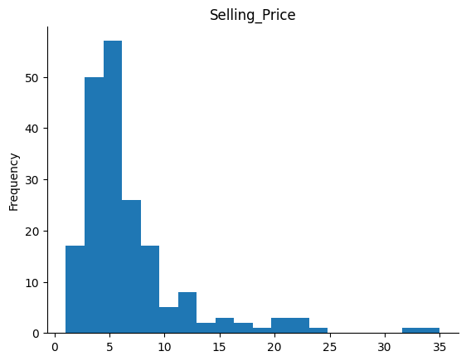
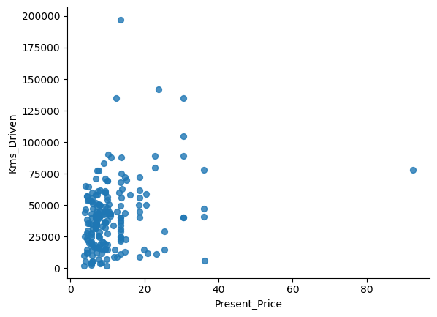
Visualization Part 1
Present Price vs Kms Driver

Slide 12
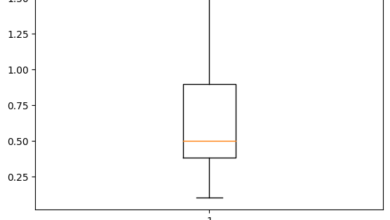
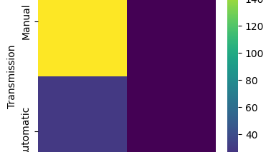
Visualisation Part 2
Box plot under the expectation
Seller_Type vs Transmission

Slide 13
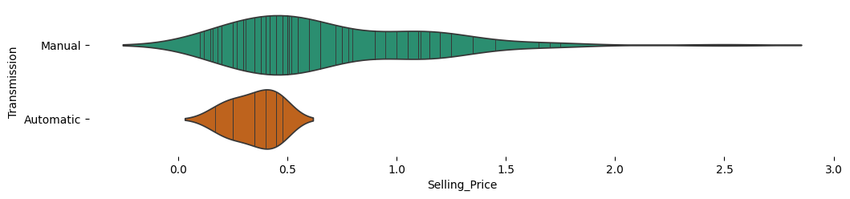
Transmission vs Selling Price

